Slide 1


Basil Norman
18th September 2022

Slide 2

Outline
Executive Summary
Introduction
Methodology
Results
Conclusion
Appendix

Slide 3
Executive Summary
Summary of methodologies
Data Collection
EDA Data Visualization
EDA With SQL
Building an Interactive Map with Folium
Building a Dashboard with Ploty
Predictive Analysis
Summary of all results
EDA Results
Interactive Analytics
Predictive Analysis

Slide 4
Introduction
Project background and context
SpaceX advertises Falcon 9 rocket launches, with a cost of 62 million dollars; while others cost upward of 165 million dollars each.
Problems you want to find answers
The project task is to predict if the first stage of the SpaceX Falcon 9 rocket will land successfully.

Slide 5

Section 1

Slide 6
Methodology
Executive Summary
Data collection methodology:
Data was collected using SpaceX API and web scraping from Wikipedia.
Perform data wrangling
One Hot Encoding data field for Machine Learning and data cleaning of null values.
Perform exploratory data analysis (EDA) using visualization and SQL
Perform interactive visual analytics using Folium and Plotly Dash
Perform predictive analysis using classification models
KNN, DT, LR, SVM models were built and evaluated for the best classifier.

Slide 7
Data Collection
The was collected using multiple methods.
Data Collection was completed using requests sent to the SpaceX API.
The next step was to decode the content of the Json reponse using the .json() function and after transform it into a pandas dataframe using .json_normalize().
Various data wrangling techniques were used to clean the data by checking for missing values and filling in missing values where needed.
Another means of collecting data was via Wikipedia.
The was collected using webscraping from Wikipedia for Falcon 9 launch records with BeautifulSoup. After launch records were parsed from the HTML table returned and transformed to a pandas dataframe.

Slide 8
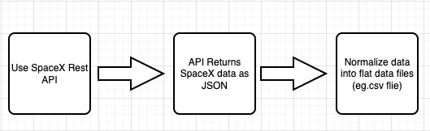
Data Collection – SpaceX API
Get requests were sent to the SpaceX API to collect data.
The link to the notebook is below
https://github.com/basilcloud/IBM-Capstone/blob/main/jupyter-labs-spacex-data-collection-api.ipynb

Slide 9
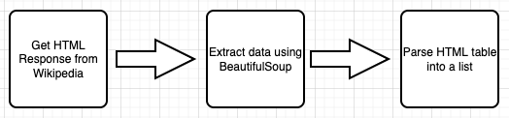
Data Collection - Scraping
Webscraping was applied to get the Falcon 9 launch records with BeautifulSoup
The link to the notebook is below.
https://github.com/basilcloud/IBM-Capstone/blob/main/jupyter-labs-webscraping.ipynb

Slide 10
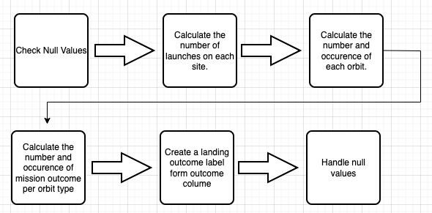
Data Wrangling
The data needs to be clean due to missing values. Calculations were done to get the number of launched, occurrence of each orbit and the occurrence of mission outcome per orbit type and also to handle null values.
https://github.com/basilcloud/IBM-Capstone/blob/main/labs-jupyter-spacex-Data%20wrangling.ipynb

Slide 11
EDA with Data Visualization
We used visuals to explore the relationship between flight numbers and launch site, the success rate of each orbit type, flight number, and orbit type, launch success yearly trend.
Visuals:
- Scatter Plot
- Bar Graph
- Line Graph
https://github.com/basilcloud/IBM-Capstone/blob/main/jupyter-labs-eda-dataviz.ipynb

Slide 12
EDA with SQL
We loaded the SpaceX dataset into the database.
EDA was applied using SQL to gain insight from the data. We also wrote the below queries.
- Display the name of unique launch sites
- Display 5 records where launch sites begin with the string 'CCA'
- Display the total payload mass carried by boosters launched by NASA (CRS)
- Display average payload mass carried by booster version F9 v1.1
- List the date when the first successful landing outcome in ground pad was achieved.
- List the names of the boosters which have success in drone ship and have payload mass greater than 4000 but less than 6000.
https://github.com/basilcloud/IBM-Capstone/blob/main/jupyter-labs-eda-sql-coursera_sqllite.ipynb

Slide 13
Build an Interactive Map with Folium
We used the Latitude and Longitude Coordinates to visualize the launch data into an interactive map. With the coordinates, we added a circle marker around each launch site with a label of the name of the launch site.
We assigned the feature launch outcomes(failure or success) to class 0 and 1. 0 for failure, and 1 for success.
We calculated the distances between a launch site to its proximities. We were able to identify:
Are launch sites near railways, highways and coastlines.
Do launch sites keep certain distance away from cities.
https://github.com/basilcloud/IBM-Capstone/blob/main/lab_jupyter_launch_site_location.ipynb

Slide 14
Build a Dashboard with Plotly Dash
Using Plotly dash we built an interactive dashboard.
We plotted charts showing the total launches by certain sites.
We plotted graphs showing the relationship with Outcome and Payload Mass.

Slide 15
Predictive Analysis (Classification)
The data was loaded using NumPy and pandas, transformed the data, and split our data into training and testing.
Built different machine learning models and tune different hyperparameters using GridSearchCV.
We checked the accuracy of our model and improved the model using feature engineering and algorithm tuning.
We found the best performing classification model.
https://github.com/basilcloud/IBM-Capstone/blob/main/SpaceX_Machine%20Learning%20Prediction_Part_5%20(1).ipynb

Slide 16
Results
Exploratory data analysis results
Interactive analytics demo in screenshots
Predictive analysis results

Slide 17

Section 2

Slide 18
Flight Number vs. Launch Site
Show a scatter plot of Flight Number vs. Launch Site
Show the screenshot of the scatter plot with explanations

Slide 19
Payload vs. Launch Site
Show a scatter plot of Payload vs. Launch Site
Show the screenshot of the scatter plot with explanations

Slide 20
Success Rate vs. Orbit Type
Show a bar chart for the success rate of each orbit type
Show the screenshot of the scatter plot with explanations

Slide 21
Flight Number vs. Orbit Type
Show a scatter point of Flight number vs. Orbit type
Show the screenshot of the scatter plot with explanations

Slide 22
Payload vs. Orbit Type
Show a scatter point of payload vs. orbit type
Show the screenshot of the scatter plot with explanations

Slide 23
Launch Success Yearly Trend
Show a line chart of yearly average success rate
Show the screenshot of the scatter plot with explanations

Slide 24
All Launch Site Names
Find the names of the unique launch sites
Present your query result with a short explanation here

Slide 25
Launch Site Names Begin with 'CCA'
Find 5 records where launch sites begin with `CCA`
Present your query result with a short explanation here

Slide 26
Total Payload Mass
Calculate the total payload carried by boosters from NASA
Present your query result with a short explanation here

Slide 27
Average Payload Mass by F9 v1.1
Calculate the average payload mass carried by booster version F9 v1.1
Present your query result with a short explanation here

Slide 28
First Successful Ground Landing Date
Find the dates of the first successful landing outcome on ground pad
Present your query result with a short explanation here

Slide 29
Successful Drone Ship Landing with Payload between 4000 and 6000
List the names of boosters which have successfully landed on drone ship and had payload mass greater than 4000 but less than 6000
Present your query result with a short explanation here

Slide 30
Total Number of Successful and Failure Mission Outcomes
Calculate the total number of successful and failure mission outcomes
Present your query result with a short explanation here

Slide 31
Boosters Carried Maximum Payload
List the names of the booster which have carried the maximum payload mass
Present your query result with a short explanation here

Slide 32
2015 Launch Records
List the failed landing_outcomes in drone ship, their booster versions, and launch site names for in year 2015
Present your query result with a short explanation here

Slide 33
Rank Landing Outcomes Between 2010-06-04 and 2017-03-20
Rank the count of landing outcomes (such as Failure (drone ship) or Success (ground pad)) between the date 2010-06-04 and 2017-03-20, in descending order
Present your query result with a short explanation here

Slide 34

Section 3

Slide 35
<Folium Map Screenshot 1>
Replace <Folium map screenshot 1> title with an appropriate title
Explore the generated folium map and make a proper screenshot to include all launch sites’ location markers on a global map
Explain the important elements and findings on the screenshot

Slide 36
<Folium Map Screenshot 2>
Replace <Folium map screenshot 2> title with an appropriate title
Explore the folium map and make a proper screenshot to show the color-labeled launch outcomes on the map
Explain the important elements and findings on the screenshot

Slide 37
<Folium Map Screenshot 3>
Replace <Folium map screenshot 3> title with an appropriate title
Explore the generated folium map and show the screenshot of a selected launch site to its proximities such as railway, highway, coastline, with distance calculated and displayed
Explain the important elements and findings on the screenshot

Slide 38

Section 4

Slide 39
<Dashboard Screenshot 1>
Replace <Dashboard screenshot 1> title with an appropriate title
Show the screenshot of launch success count for all sites, in a piechart
Explain the important elements and findings on the screenshot

Slide 40
<Dashboard Screenshot 2>
Replace <Dashboard screenshot 2> title with an appropriate title
Show the screenshot of the piechart for the launch site with highest launch success ratio
Explain the important elements and findings on the screenshot

Slide 41
<Dashboard Screenshot 3>
Replace <Dashboard screenshot 3> title with an appropriate title
Show screenshots of Payload vs. Launch Outcome scatter plot for all sites, with different payload selected in the range slider
Explain the important elements and findings on the screenshot, such as which payload range or booster version have the largest success rate, etc.

Slide 42

Section 5

Slide 43
Classification Accuracy
Visualize the built model accuracy for all built classification models, in a bar chart
Find which model has the highest classification accuracy

Slide 44
Confusion Matrix
Show the confusion matrix of the best performing model with an explanation

Slide 45
Conclusions
We conclude that:
The larger the flight amount at a launch site, the greater the success rate at a launch site.
Launch success rate started to increase in 2013 till 2020.
The Decision tree classifier is the best machine learning algorithm for this task.
KSC-LC-39A had the most successful launches of any sites.

Slide 46
Appendix
Include any relevant assets like Python code snippets, SQL queries, charts, Notebook outputs, or data sets that you may have created during this project

Slide 47


